Slide 1
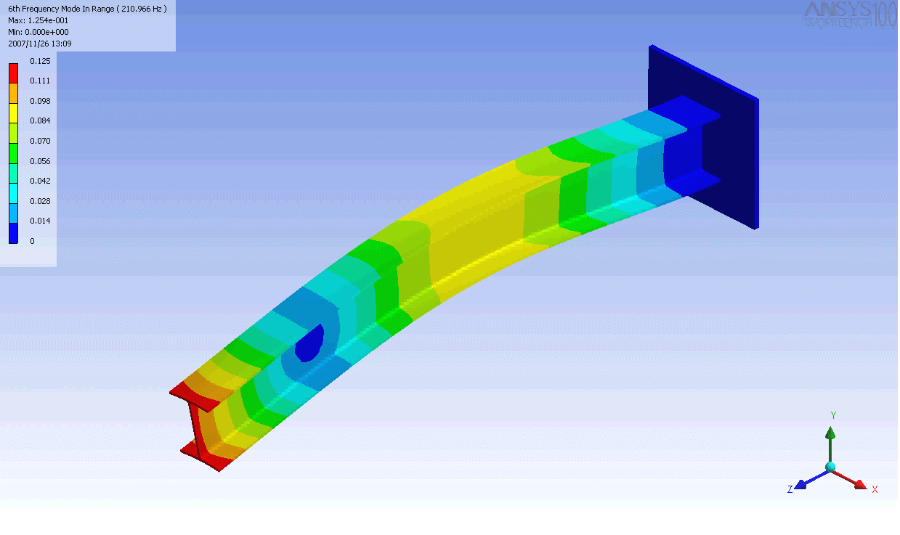
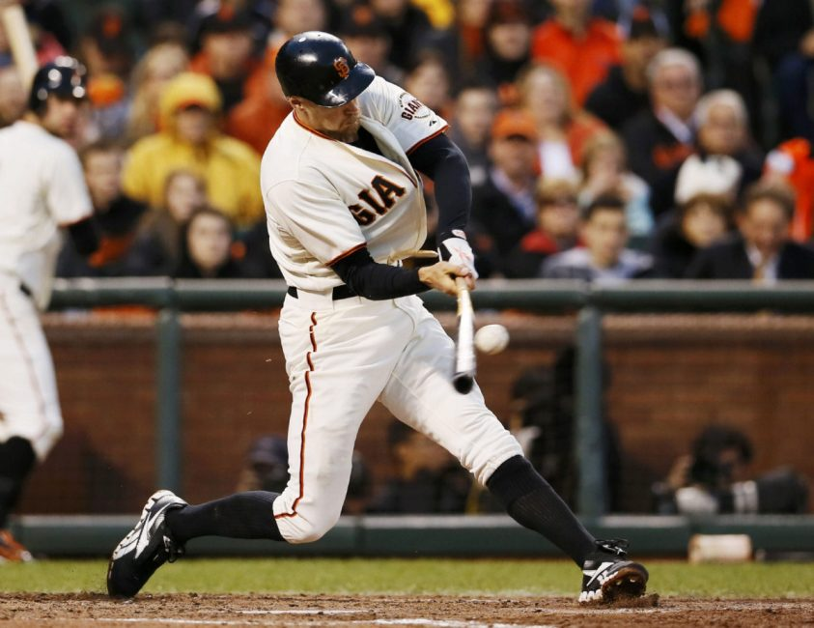
A10 - Cantilever Vibrations
Baseball bat undergoes cantilever vibrations after striking a ball.

Slide 2
Fourier Transform
AMPLITUDE vs. FREQUENCY
“Spectral Density”
AMPLITUDE vs. TIME
FFT
PHASE vs. FREQUENCY

Slide 3
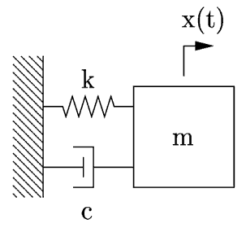
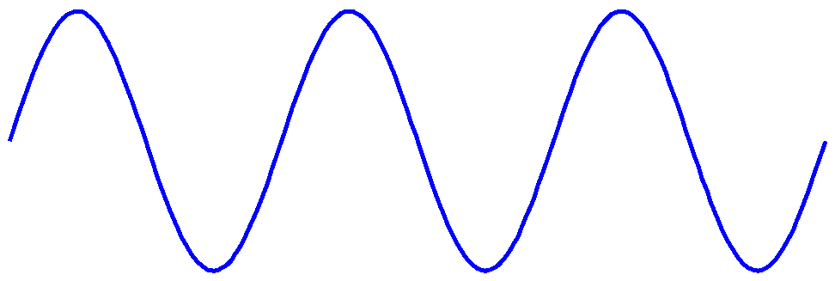
A10 - Piezoelectric Pressure Transducer
Function generator
Oscilloscope
Piezo
Transmitter
Piezo
Receiver
Acoustic
waves

Slide 4
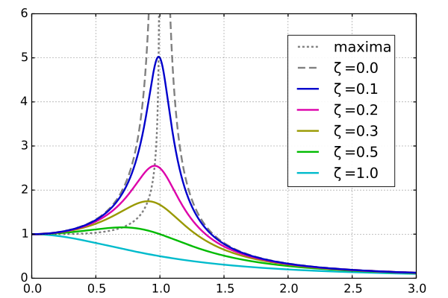
A10 - 2nd Order Response
Driven response, amplitude vs. freq.
ω/ω₀

Slide 5
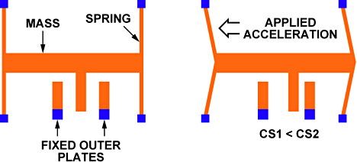
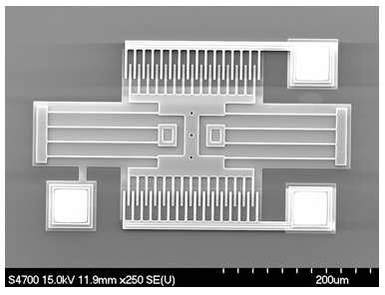
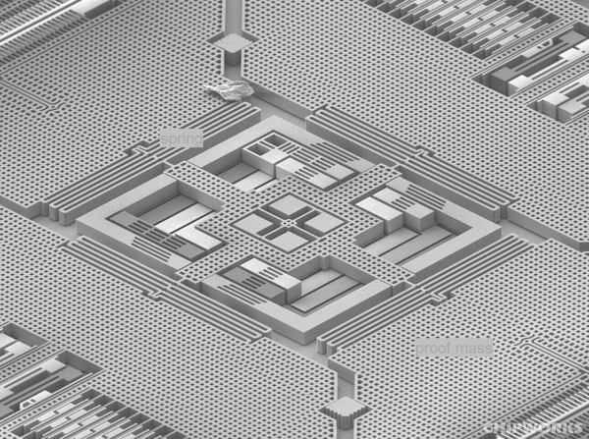
MEMS Accelerometers
Acceleration causes mass to push on spring and displace the “interdigitated” electrodes,
changes electric capacitance.
Micro-Electro-Mechanical Systems (MEMS)
3-axis gyro from an iPhone 4

Slide 6
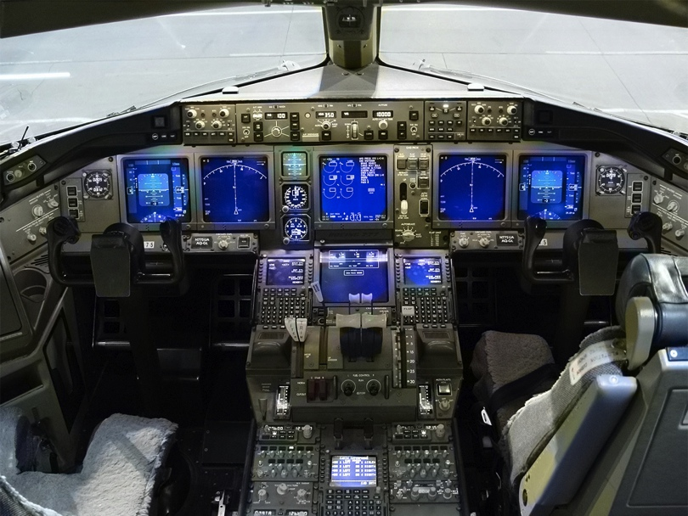
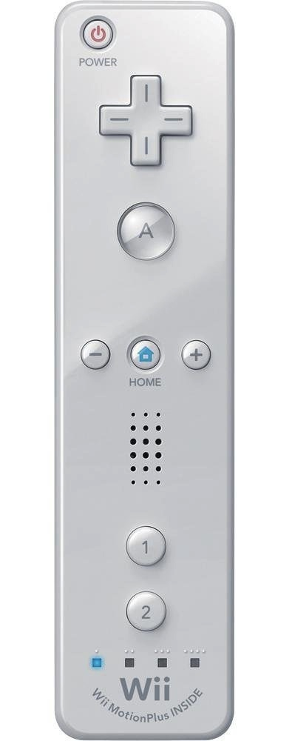

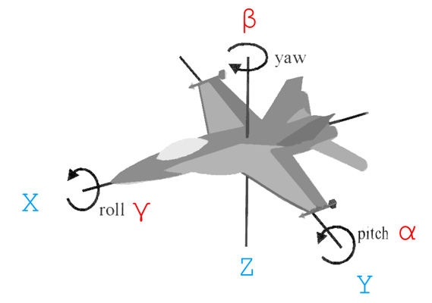
Accelerometers
Boeing 777 glass cockpit.

Slide 7
Lab1 Accelerometer Calibration
Voltage linearly related to acceleration:
2-point calibration
y
At θ = 0º, a_{y} = 0, V_{OUT} = V₀
ACC
g
At θ = 90º, a_{y} = g, V_{OUT} = V₉₀
θ

Slide 8
Quadrature Encoders
A Quadrature encoder counts electrical pulses as slotted wheel passes through a photocell.
Measures angular position and speed.

Slide 9
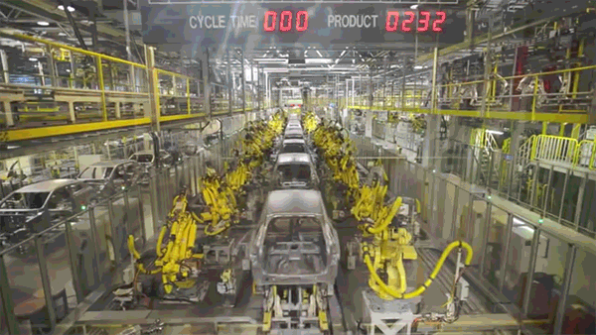
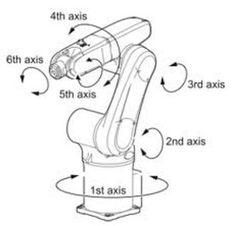
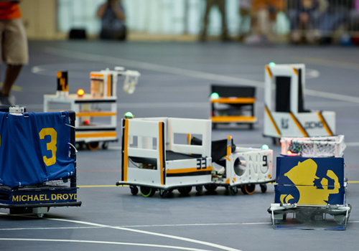
Orientation
Mechanical parts can rotate to various angles.
Robot football

Slide 10
Single pendulum: Predictable motion
One degree of freedom: θ
Damped harmonic oscillator

Slide 11
Double pendulum: Chaotic motion
Two degrees of freedom: θ₁ and θ₂ .

Slide 12
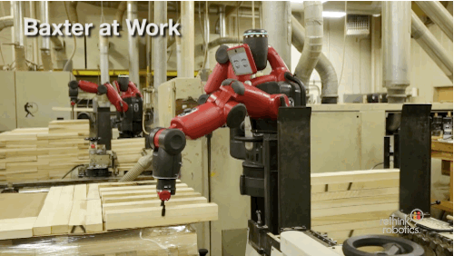
Mechanical Control
Understanding and controlling complex mechanic systems is hard!

Slide 13
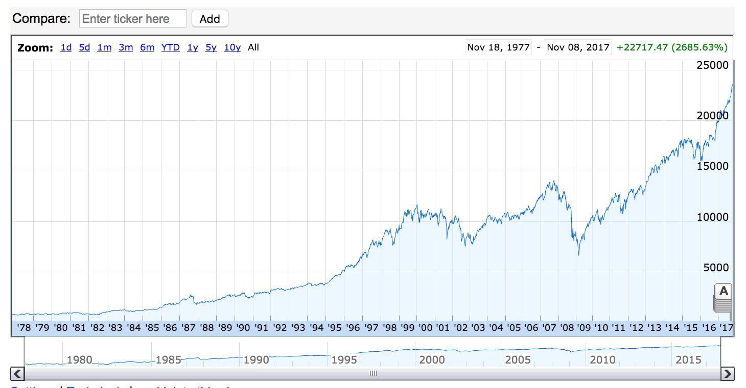
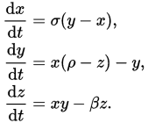
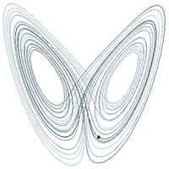
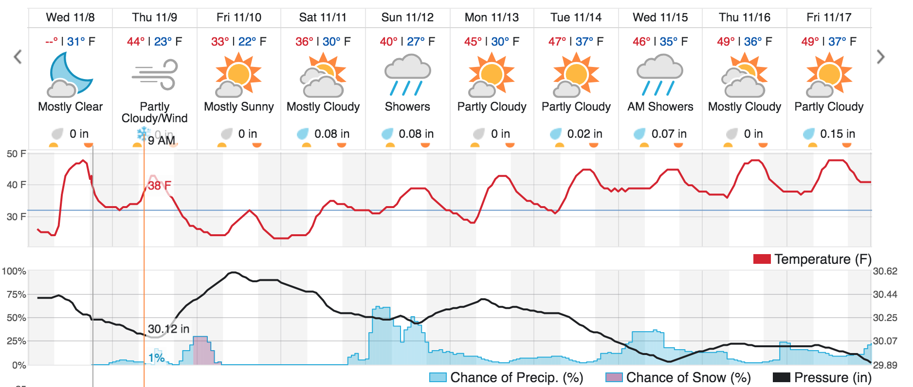
Chaos!
Complex systems are extremely sensitive to initial conditions.

Slide 14
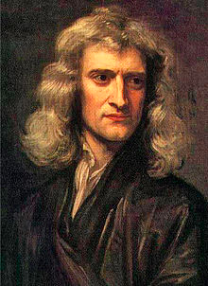
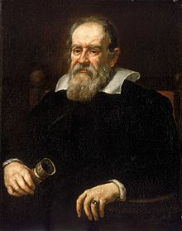
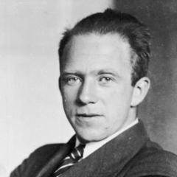
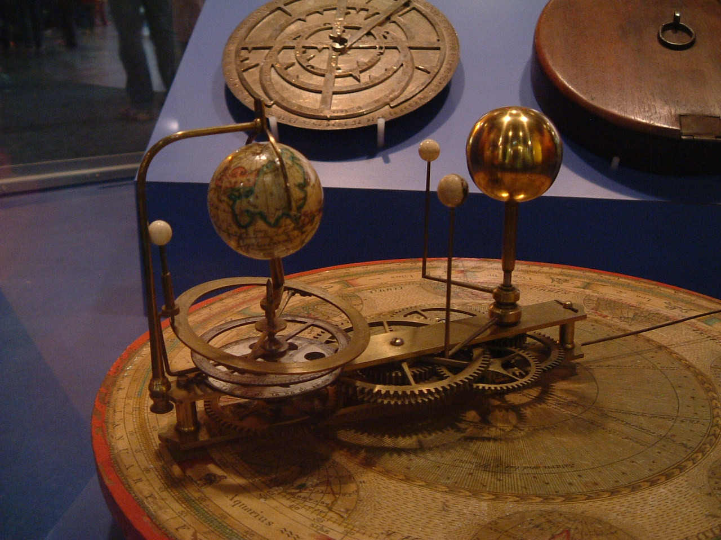

Clockwork vs. Chaos!
Thinkers of yore believed the universe behaved as “Clockwork”
Modern thinkers have embraced the unpredictability of things.

Slide 15

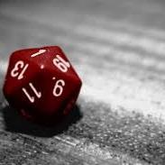
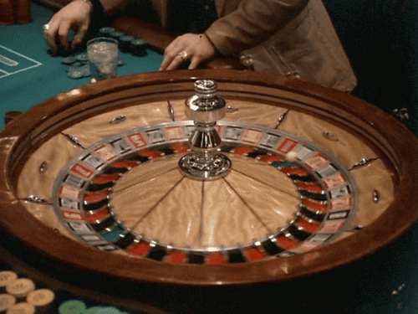
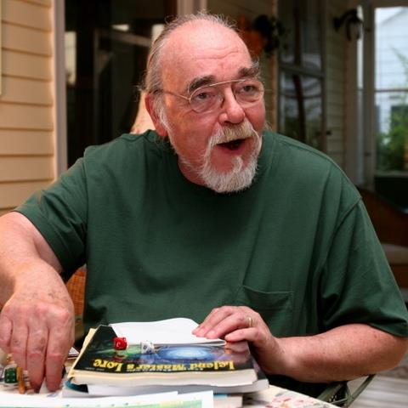
Unpredictable Systems

Slide 16

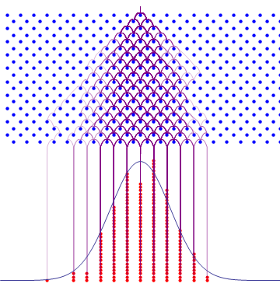
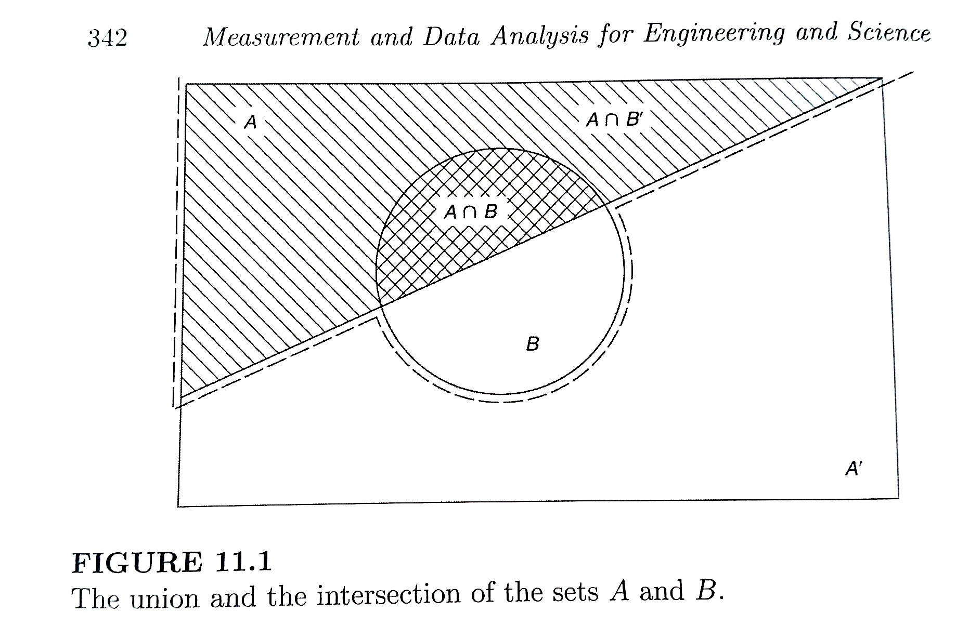
Probability and Statistics

